Slide 1
A Virtual Cluster System to be Used on a Wide-area Network in the PRAGMA Grid Test-bed
PRAGMA18 Demonstration
2-4 March 2010
Kei Kokubo, Yasuyuki Kusumoto, Susumu Date
Osaka University, Cybermedia Center
Wen-Wai Yim, Jason Haga
Department of Bioengineering, University of California, San Diego
Notes:
Thank you for inviting me, Mr chairman.
My name is Kei Kokubo.
I’m from Osaka University in Japan.
Today, I will demonstrate an example of building a virtual cluster which we propose.
This is Wen-wai, a student at here UCSD, and she is one of the PRIME students last year at Osaka University.
She will introduce her work with our virtual cluster system.
We aim to build a virtual cluster system to be used on a wide-area network like the PRAGMA Grid test-bed.
So we hope this demonstration leads to new collaboration among PRAGMA members.

Slide 2




overview of our virtual cluster system
The concept:
Dynamically aggregate available resources from different organizations on the basis of user’s request
Provide a user with a private virtual cluster
Virtual Cluster
VM
VM
VM
VM
Virtual node
Virtual node
Overlay Network
Organization B
Organization A
Physical network
Organization C
Notes:
First, I’d like to introduce the overview of our system.
The concept is that our system dynamically aggregates available resources from different organizations on the basis of user’s request and provides a user with a private virtual cluster.
Our virtual cluster is built as the following.
First, an overlay network is constructed among every computational resource of different organizations like A, B and C.
Our system dynamically gathers and selects available resources on the overlay network through a resource discovery function realized by the overlay network.
After that, our system deploys virtual machines on the selected resources.
And then, our system forms a virtual private network among them utilizing a communication relay mechanism we implemented.
At last, the user can utilize a set of virtual machines as a single virtual cluster.
/*
First, an overlay network is constructed by every computational resource.
users can build a customized virtual cluster for their application without considering where each virtual machines is from.
aggregating computational resources on an overlay network. They do not need to consider where each virtual machines is from.
First, we assume that every computational resources is composed of an overlay network.
After that, we make virtual machines comprised of a virtual cluster not just a set of virtual machines.
*/

Slide 3
Demonstration
Utilize three nodes from each of two clusters located at Osaka University
Flow of Demonstration
access to a Web portal to build a virtual cluster
set and submit some requirements for the deployment
submit an example job into the virtual cluster
Web Portal
Virtual Cluster
VM
Overlay Network
VM
VM
VM
moca
latte
Notes:
In this slide, let me explain what I demonstrate briefly.
In this demonstration, we will build a virtual cluster utilizing moca and latte clusters which are located at Osaka University as computational resources.
The flow of demonstration is the following.
First I access and login to a web portal.
Through the web portal, I set and submit some requirements for deployment of a virtual cluster.
Then computational resources available to deploy a virtual machine are automatically chosen on the basis of my request and finally a virtual cluster is built.
After that, I will try to submit an example job into the virtual cluster.

Slide 4
Demonstration
Notes:
I’d like to make a demonstration.
******demo******
****************

Slide 5
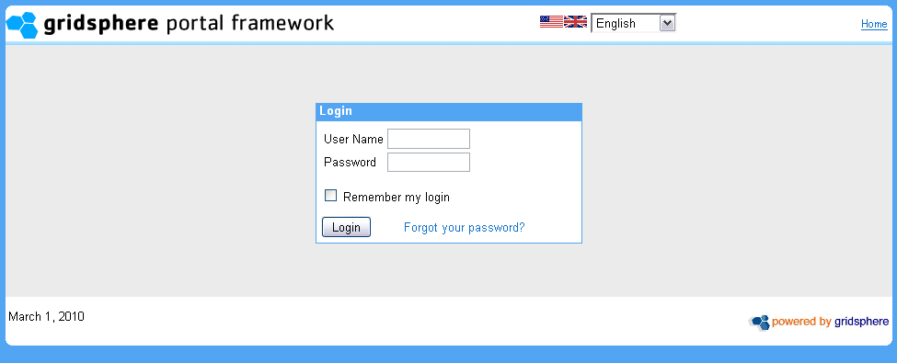
Notes:
This is a web portal for deployment of our virtual cluster.
This utilizes gridsphere portal framework.
This time, I login as admin user and fill in a password form.

Slide 6
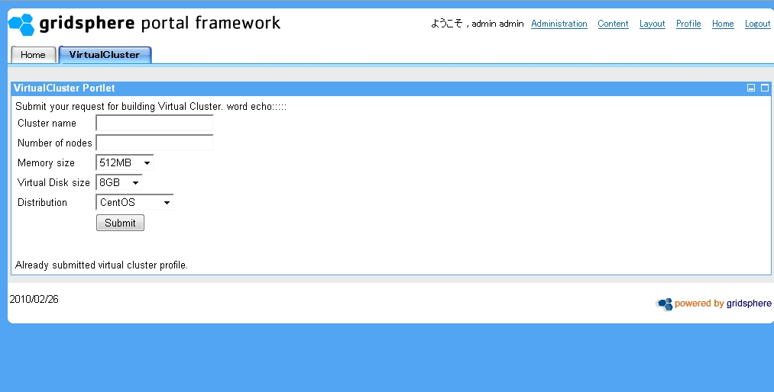
Notes:
Ok I entered.
For the first step of building a virtual cluster, I have to fill some forms (like these) to send a request including requirements.
First I set the name of my virtual cluster.
This time I set the name of it “susumu”.
Second I request how many computational resources I need.
Here I choose 4.
And I also select memory size, disk size and distribution of operation system of my virtual cluster.
This time we only deploy a virtual machine with 512MB memory and 8GB virtual disk and CentOS.
So I retain these selections.
This information is used to discover appropriate available computational resources on an overlay network.
After that I start the process of deployment of a virtual cluster by clicking this submit button.

Slide 7
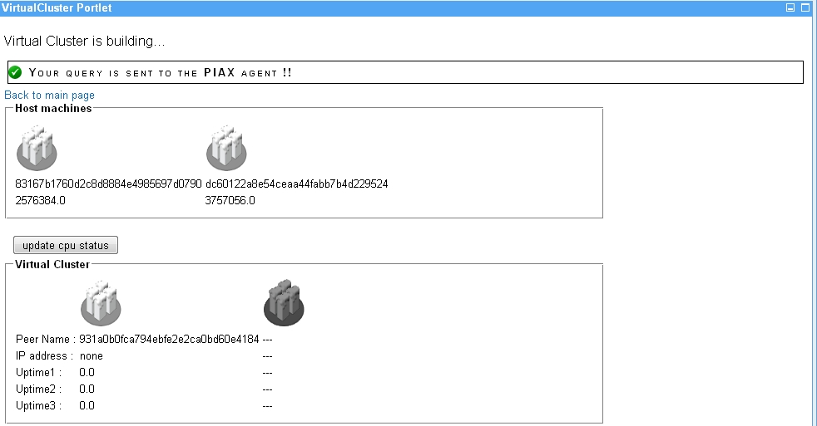
Notes:
This page shows the information of resources.
This list (指さして) shows all computational resources on an overlay network.
I prepare three nodes from each of moca and latte cluster. Name of the cluster and memory size of the resources are described in the list.
And this (指さして) shows selected nodes from all available nodes.
Here 4 nodes are randomly selected.
According to this, we can find one is from latte cluster and another three is from moca cluster.
(latte 1つ moca ２つの場合)
Now, The process of deployment of a virtual cluster has started as shown in the message on.
But it takes a few minutes to finish building a virtual cluster.
So, during the building, I’d like to show you the requirements for our virtual cluster system.
/* go to requirement */

Slide 8
Requirements
Xen
Need for virtualization
OpenVPN
Need to provide a single private network address space among virtual machines and user’s machine
PIAX
Need to organize an overlay network
Discover appropriate resources for a user
Realize IP-based end-to-end communication on the overlay network relaying the connection of the OpenVPN
Java 5 or latter versions are needed
Notes:
The requirements are Xen, OpenVPN and PIAX.
Xen is needed for virtualization of selected computational resources.
OpenVPN is needed to provide a single private network address space among virtual machines and a user’s machine.
PIAX is needed to organize an overlay network.
The overlay network provides two functions which help to discover appropriate resources for a user and to realize IP-based end-to-end communication on the overlay network relaying the connection of the OpenVPN.
Additionally, to launch PIAX, Java version 5 or latter versions are needed.
オーバレイネットワーク上でVPNの通信を中継する必要性を聞かれるかも。。。
Because of network disconnective among

Slide 9
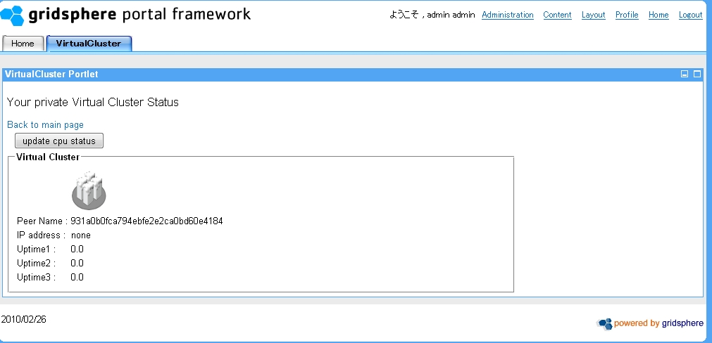
Notes:
This page shows the status of my virtual cluster such as role and private IP address and uptime information.
(クラスタの色が黒かったら：Now the construction of my virtual cluster has not finished yet, so I will click again this update cpu status line)
Now my virtual cluster is completely built.
We can see the information of each virtual node, monitoring load of the nodes.
One virtual machine is selected as a master node.
Now, I’d like to submit an example job into my private virtual cluster.
This time I try to access the virtual cluster through a remote host utilizing our communication relay mechanism to establish the same private network with virtual cluster.
(用意していたpoderosaのmoca c0-8のシェルを見せて) This is a remote shell at the node.
All I have to do on the node is to just type “./start” command.
This tun-00 is a virtual network interface and I can see that I get a virtual IP address connecting to my virtual cluster.
Then, I enter the master node of the virtual cluster by “ssh” command.
I submit three jobs by “qsub” command provided PBS scheduler like this.
/*
To connect to the virtual cluster, this time I establish IP-based end-to-end communication between virtual cluster and another node of moca cluster utilizing our communication relay mechanism.
To submit a job I enter to master node of the virtual cluster.
*/

Slide 10
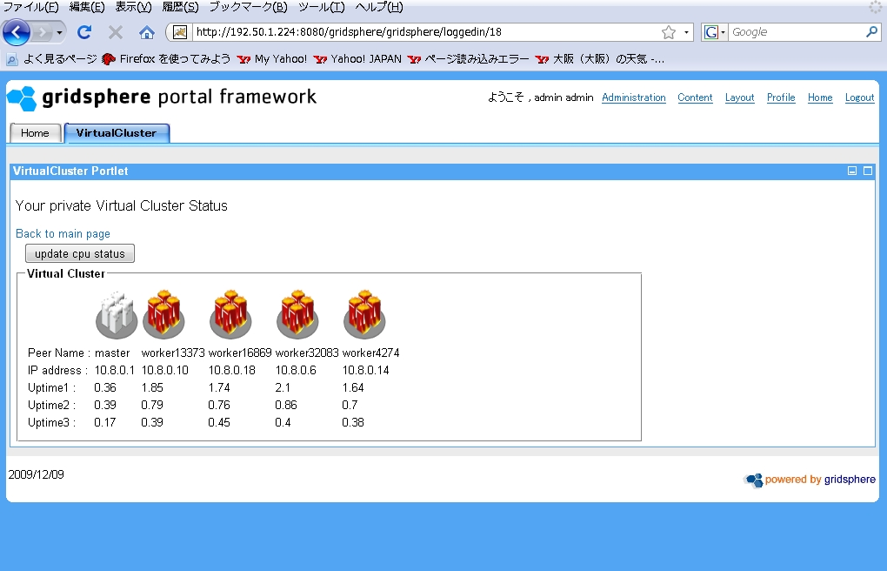
Notes:
(update cpu statusを押してから)
And we can confirm my jobs are executed on worker nodes of the virtual cluster.

Slide 11
summary
We believe our system will help scientists and researchers to deploy their private virtual cluster on available resources from different organizations.
Wen-wai actually verified the possibility of our proposed virtual cluster
The virtual cluster deploys an appropriate computational environment for her application.
Notes:
In conclusion, we believe that our system will help scientists and researchers to deploy their private virtual cluster on available resources from different organizations.
This year, Wen-wai, actually verified the possibility of our proposed virtual cluster and as a result of this, our virtual cluster deploys an appropriate computational environment for her application.
Now she will introduce her work.

Slide 12
Dock 6.2, a grid application
Developed by UCSF
Free, constantly improving
Models ligand/receptor interactions
Dock score:
sum of the van der Waals attractive, van der Waal dispersive and Coulombic electrostatic energies
Time
http://dock.compbio.ucsf.edu/Overview_of_DOCK/index.htm
Ligands/Receptor from ZINC database
http://zinc.docking.org

Slide 13
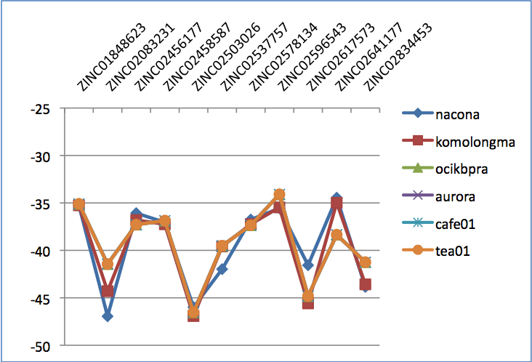
Pragma Dock 6.2 Results
 | Developer's | nacona | komolongma | ocikbpra | aurora | cafe01 | tea01
OS-bit |  | 64 | 32 | 32 | 32 | 32 | 32
machine bit |  | 64 | 32 | 32 | 32 | 32 | 32
gcc version |  | 3.4.6 | 4.1.2 | 3.4.6 | 3.4.6 | 3.4.6 | 3.4.6
ID | Scores
ZINC00013564 | 10.801939 | -9.40022 | 10.801939 | -9.40021 | -9.40021 | -9.40021 | -9.40021
ZINC00150863 | 21.139143 | -12.4672 | 21.139143 | 21.13914 | 21.13914 | 21.13914 | 21.13914
ZINC00152265 | 30.238361 | 30.23803 | 30.238361 | 19.05393 | 19.05393 | 19.05393 | 19.05393
ZINC00158442 | 52.56588 | 52.56579 | 52.56588 | 52.56588 | 52.56588 | 52.56588 | 52.56588
ZINC00158751 | -1.058107 | -1.05816 | -1.058107 | -1.05811 | -1.05811 | -1.05811 | -1.05811
ZINC01555236 | 503.249725 | 5.02E+08 | 503.249725
 | Developer's | nacona | komolongma | ocikbpra | aurora | cafe01 | tea01
OS-bit |  | 64 | 32 | 32 | 32 | 32 | 32
machine bit |  | 64 | 32 | 32 | 32 | 32 | 32
gcc version |  | 3.4.6 | 4.1.2 | 3.4.6 | 3.4.6 | 3.4.6 | 3.4.6
ID | Scores
ZINC00013564 | 10.801939 | -9.40022 | 10.801939 | -9.40021 | -9.40021 | -9.40021 | -9.40021
ZINC00150863 | 21.139143 | -12.4672 | 21.139143 | 21.13914 | 21.13914 | 21.13914 | 21.13914
ZINC00152265 | 30.238361 | 30.23803 | 30.238361 | 19.05393 | 19.05393 | 19.05393 | 19.05393
ZINC00158442 | 52.56588 | 52.56579 | 52.56588 | 52.56588 | 52.56588 | 52.56588 | 52.56588
ZINC00158751 | -1.058107 | -1.05816 | -1.058107 | -1.05811 | -1.05811 | -1.05811 | -1.05811
ZINC01555236 | 503.249725 | 5.02E+08 | 503.249725
 | Developer's | nacona | komolongma | ocikbpra | aurora | cafe01 | tea01
OS-bit |  | 64 | 32 | 32 | 32 | 32 | 32
machine bit |  | 64 | 32 | 32 | 32 | 32 | 32
gcc version |  | 3.4.6 | 4.1.2 | 3.4.6 | 3.4.6 | 3.4.6 | 3.4.6
ID | Scores
ZINC00013564 | 10.801939 | -9.40022 | 10.801939 | -9.40021 | -9.40021 | -9.40021 | -9.40021
ZINC00150863 | 21.139143 | -12.4672 | 21.139143 | 21.13914 | 21.13914 | 21.13914 | 21.13914
ZINC00152265 | 30.238361 | 30.23803 | 30.238361 | 19.05393 | 19.05393 | 19.05393 | 19.05393
ZINC00158442 | 52.56588 | 52.56579 | 52.56588 | 52.56588 | 52.56588 | 52.56588 | 52.56588
ZINC00158751 | -1.058107 | -1.05816 | -1.058107 | -1.05811 | -1.05811 | -1.05811 | -1.05811
ZINC01555236 | 503.249725 | 5.02E+08 | 503.249725
Graph I. DOCK 6.2 scores from virtual screenings across PRAGMA clusters
Graph I. Visualization of DOCK 6.2 scores over PRAGMA Grid

Slide 14
Virtual cluster Dock 6.2 Results
Table II. DOCK 6.2 Scores of Virtual Clusters Compared with Physical Clusters
 | Developer's | coregrid | Latte | VC_coregrid | VC_latte
OS-bit |  | 64 | 32 | 32 | 32
machine bit |  | 64 | 32 | 64 | 32
gcc version |  | 4.1.2 | 4.1.2 | 3.4.6 | 3.4.6
ID | Scores
ZINC00013564 | 10.801939 | -9.40022 | 10.80194 | -9.40021 | -9.40021
ZINC00150863 | 21.139143 | -12.4672 | 21.13914 | 21.13914 | 21.13914
ZINC00152265 | 30.238361 | 30.23803 | 30.23836 | 19.05393 | 19.05393
ZINC00158442 | 52.56588 | 52.56579 | 52.56588 | 52.56588 | 52.56588
ZINC00158751 | -1.058107 | -1.05816 | -1.05811 | -1.05811 | -1.05811
ZINC01555236 | 503.249725 | 5.02E+08 | 503.2497
 | Developer's | coregrid | Latte | VC_coregrid | VC_latte
OS-bit |  | 64 | 32 | 32 | 32
machine bit |  | 64 | 32 | 64 | 32
gcc version |  | 4.1.2 | 4.1.2 | 3.4.6 | 3.4.6
ID | Scores
ZINC00013564 | 10.801939 | -9.40022 | 10.80194 | -9.40021 | -9.40021
ZINC00150863 | 21.139143 | -12.4672 | 21.13914 | 21.13914 | 21.13914
ZINC00152265 | 30.238361 | 30.23803 | 30.23836 | 19.05393 | 19.05393
ZINC00158442 | 52.56588 | 52.56579 | 52.56588 | 52.56588 | 52.56588
ZINC00158751 | -1.058107 | -1.05816 | -1.05811 | -1.05811 | -1.05811
ZINC01555236 | 503.249725 | 5.02E+08 | 503.2497
 | Developer's | coregrid | Latte | VC_coregrid | VC_latte
OS-bit |  | 64 | 32 | 32 | 32
machine bit |  | 64 | 32 | 64 | 32
gcc version |  | 4.1.2 | 4.1.2 | 3.4.6 | 3.4.6
ID | Scores
ZINC00013564 | 10.801939 | -9.40022 | 10.80194 | -9.40021 | -9.40021
ZINC00150863 | 21.139143 | -12.4672 | 21.13914 | 21.13914 | 21.13914
ZINC00152265 | 30.238361 | 30.23803 | 30.23836 | 19.05393 | 19.05393
ZINC00158442 | 52.56588 | 52.56579 | 52.56588 | 52.56588 | 52.56588
ZINC00158751 | -1.058107 | -1.05816 | -1.05811 | -1.05811 | -1.05811
ZINC01555236 | 503.249725 | 5.02E+08 | 503.2497
 | Developer's | coregrid | Latte | VC_coregrid | VC_latte
OS-bit |  | 64 | 32 | 32 | 32
machine bit |  | 64 | 32 | 64 | 32
gcc version |  | 4.1.2 | 4.1.2 | 3.4.6 | 3.4.6
ID | Scores
ZINC00013564 | 10.801939 | -9.40022 | 10.80194 | -9.40021 | -9.40021
ZINC00150863 | 21.139143 | -12.4672 | 21.13914 | 21.13914 | 21.13914
ZINC00152265 | 30.238361 | 30.23803 | 30.23836 | 19.05393 | 19.05393
ZINC00158442 | 52.56588 | 52.56579 | 52.56588 | 52.56588 | 52.56588
ZINC00158751 | -1.058107 | -1.05816 | -1.05811 | -1.05811 | -1.05811
ZINC01555236 | 503.249725 | 5.02E+08 | 503.2497
 | Developer's | coregrid | Latte | VC_coregrid | VC_latte
OS-bit |  | 64 | 32 | 32 | 32
machine bit |  | 64 | 32 | 64 | 32
gcc version |  | 4.1.2 | 4.1.2 | 3.4.6 | 3.4.6
ID | Scores
ZINC00013564 | 10.801939 | -9.40022 | 10.80194 | -9.40021 | -9.40021
ZINC00150863 | 21.139143 | -12.4672 | 21.13914 | 21.13914 | 21.13914
ZINC00152265 | 30.238361 | 30.23803 | 30.23836 | 19.05393 | 19.05393
ZINC00158442 | 52.56588 | 52.56579 | 52.56588 | 52.56588 | 52.56588
ZINC00158751 | -1.058107 | -1.05816 | -1.05811 | -1.05811 | -1.05811
ZINC01555236 | 503.249725 | 5.02E+08 | 503.2497
 | Developer's | coregrid | Latte | VC_coregrid | VC_latte
OS-bit |  | 64 | 32 | 32 | 32
machine bit |  | 64 | 32 | 64 | 32
gcc version |  | 4.1.2 | 4.1.2 | 3.4.6 | 3.4.6
ID | Scores
ZINC00013564 | 10.801939 | -9.40022 | 10.80194 | -9.40021 | -9.40021
ZINC00150863 | 21.139143 | -12.4672 | 21.13914 | 21.13914 | 21.13914
ZINC00152265 | 30.238361 | 30.23803 | 30.23836 | 19.05393 | 19.05393
ZINC00158442 | 52.56588 | 52.56579 | 52.56588 | 52.56588 | 52.56588
ZINC00158751 | -1.058107 | -1.05816 | -1.05811 | -1.05811 | -1.05811
ZINC01555236 | 503.249725 | 5.02E+08 | 503.2497
Table III. DOCK 6.2 Execution Times on Virtual Clusters Compared with Physical Clusters
 | coregrid | latte | VC_coregrid | VC_latte
Time Per Molecule | 13.5 ± 0.4 | 48 ± 0.4 | 18.8 ± 0.3 | 52 ± 7
Total | 674.6 ± 0.5 | 2420 ± 5 | 953 ± 2 | 2460 ± 6

Slide 15
Demonstration
Notes:
I’d like to make a demonstration.
******demo******
****************

Slide 16
CONCLUSION
Performing DOCK 6.2 experiments on a heterogeneous Grid can lead to inconsistent results.
For any scientific application, this can be a problem.
Virtual clusters can provide a solution with affordable overhead costs.

Slide 17
overview of our virtual cluster system
Develops P2P overlay network on every resources
Dynamically gathers unused computational resources from different organizations
Forms a virtual private network among the virtual machines
Virtual Cluster
VM
VM
VM
VM
Virtual node
Virtual node
Overlay Network
Organization B
Organization A
Physical network
Organization C
Notes:
First of all I’d like to introduce the overview of our system.
The concept of our system is that users can build a customized virtual cluster for their application without considering where each virtual machines is from.
Our virtual cluster are built as following.
First, every computational resource needs to be composed of an overlay network.
Our system dynamically gathers resources available from different organizations through the resource discovery function realized by overlay network.
After that, develops virtual machines on the resources
and forms a virtual private network among the virtual machines by the communication relay mechanism we implemented.
/*
aggregating computational resources on an overlay network. They do not need to consider where each virtual machines is from.
First, we assume that every computational resources is composed of an overlay network.
After that, we make virtual machines comprised of a virtual cluster not just a set of virtual machines.
*/

Slide 18
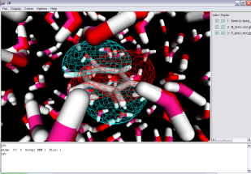
Demonstration
Utilize computational resources of two clusters located at Osaka University
access to a Web portal to develop a virtual cluster
submit some requirement for the development
Web Portal
Virtual Cluster
Overlay Network
VM
VM
VM
VM
VM
moca
latte
Notes:
In this slide, let me explain what I demonstrate.
In the demonstration, we will give an example to build a virtual cluster which utilizes moca and latte clusters which are located at Osaka University.
First I access and login to a web portal to develop a virtual cluster.
Through the web portal, I set and submit some requirement for the development.
Then automatically appropriate computational resources are chosen and a virtual cluster is built.
Finally I’ll try to submit a job of DOCK application into the virtual cluster.

